Slide 1
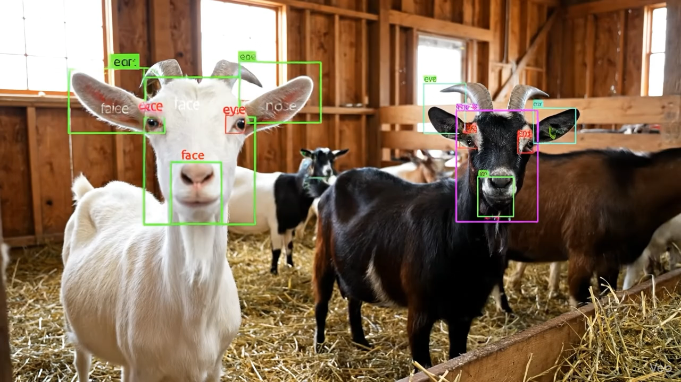
Real-Time Goat Face Recognition Using Convolutional Neural Networks (A Replication and Comparative Study)
Team Members Netid
Ifeanyi Nwaneri Nwanerii
Akintan Grace Akintano
Soumadeep Pal Palsoum1
CSE 803 - 2025
12/03/2025

Slide 2
Outline
Introduction
Methods
Results
Summary
Conclusion
References
CSE 803 - 2025

Slide 3
Introduction
CSE 803 - 2025

Slide 4
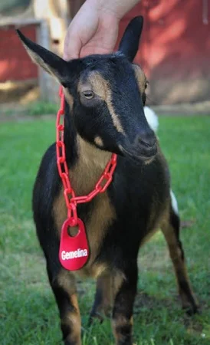
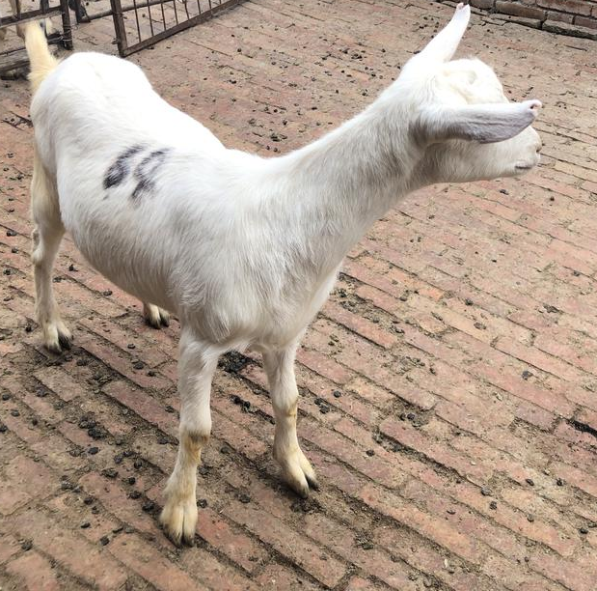
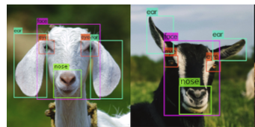
Introduction: Background & Motivation
Identifying individual animals is essential for breeding accuracy, genetic management, and welfare monitoring.
Traditional identification methods (tags, tattoos, microchips) are time-consuming, expensive, and error-prone.
Goats live in groups and look highly similar, making manual identification especially difficult.
Deep learning provides a non-invasive, automated alternative for facial identification
CSE 803 - 2025

Slide 5
Aim
To empirically validate the work of Billah et al​ for facial detection and identification of 10 Saanen goats.
Specific Objective
Implement the Image processing module as stated in the article
Implement Yolov4 for face detection
Implement a custom CNN model for face recognition
Implement alternative state-of-the-art models for both detection and identification stages of the pipeline.
CSE 803 - 2025

Slide 6
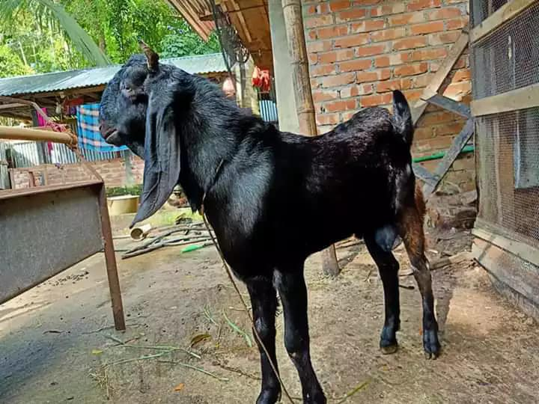
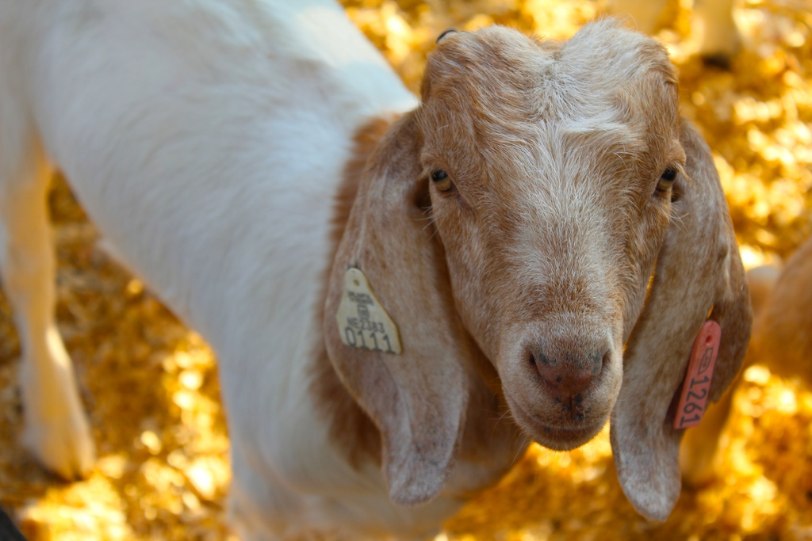
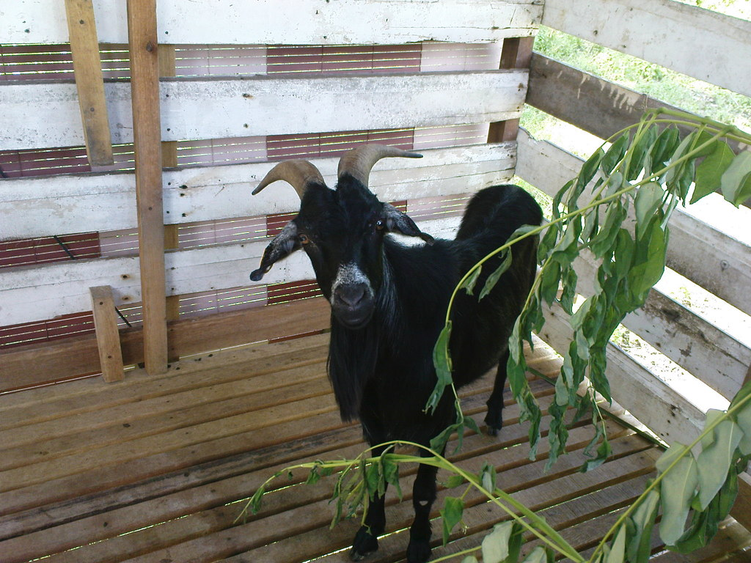
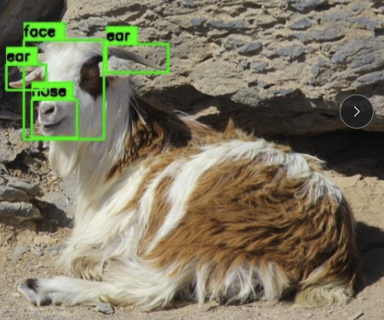
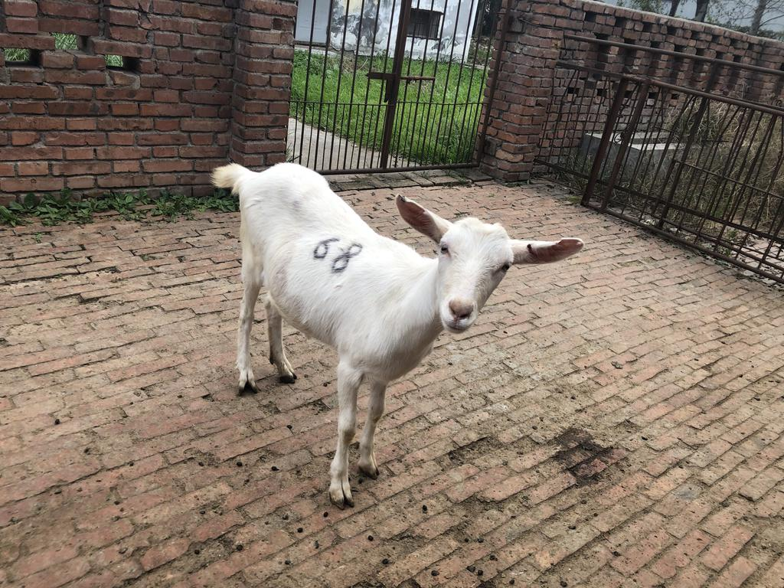
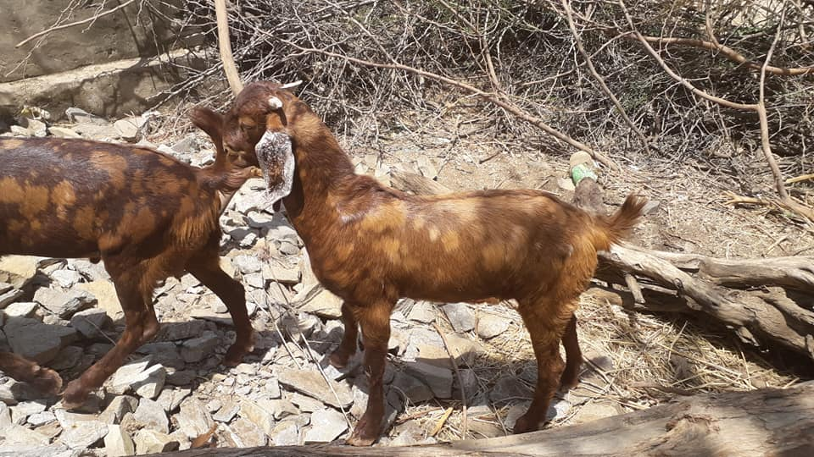
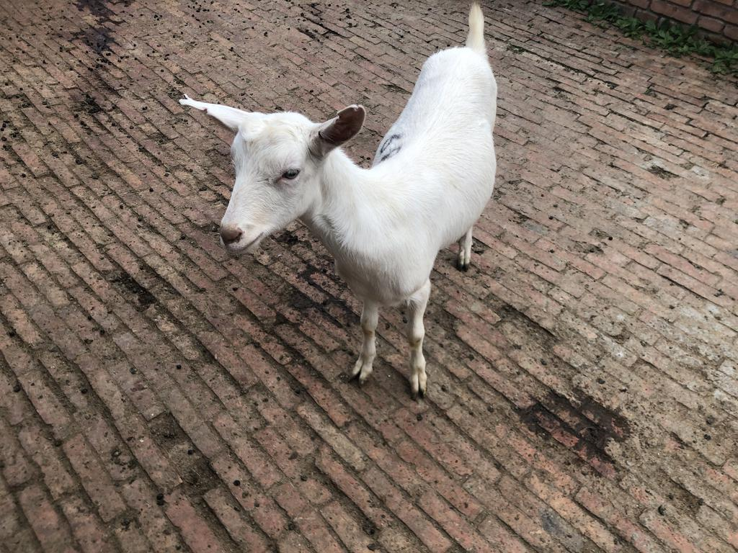
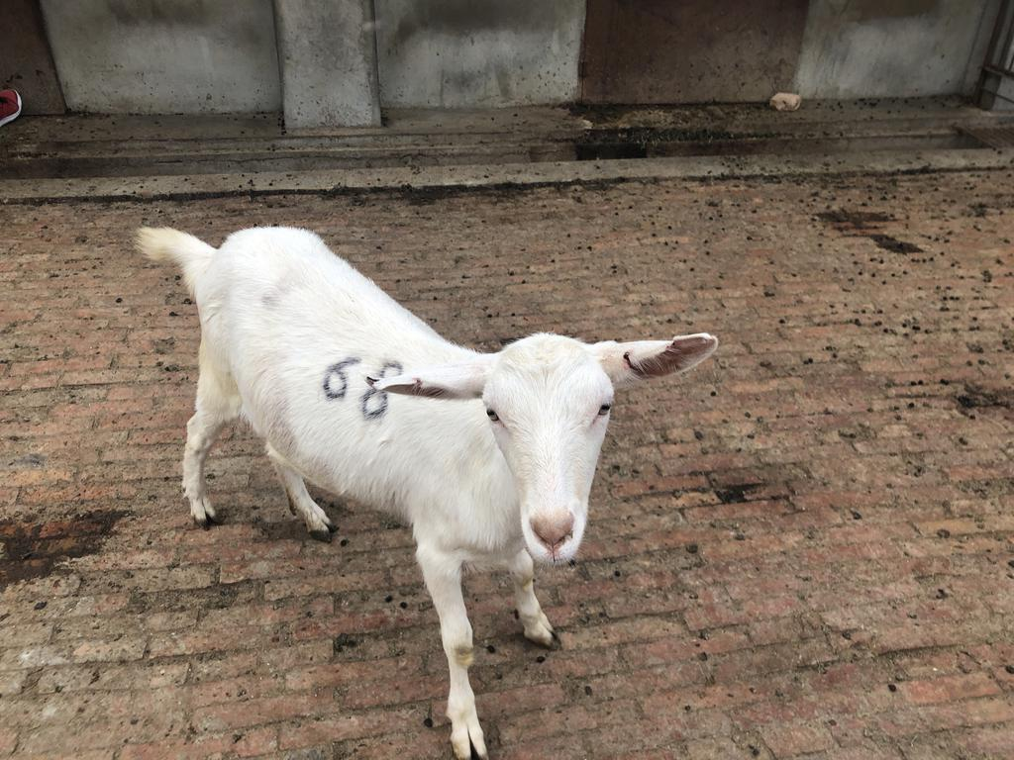
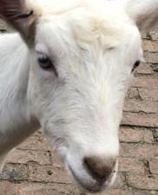
Overall Workflow
Landmark Detection
Preprocessing
Preprocessing
Face Recognition
Class A prediction Final Output
CSE 803 - 2025

Slide 7
Data Processing
CSE 803 - 2025

Slide 8
Data Overview
Two publicly available datasets were combined from prior goat face detection and recognition research.
Includes 10 individual Saanen goats, each with multiple annotated facial images.
The dataset supports two tasks:
Face Detection → bounding boxes for face, eyes, ears, nose/muzzle
Identity Recognition → cropped & aligned face images (64×64)
CSE 803 - 2025

Slide 9
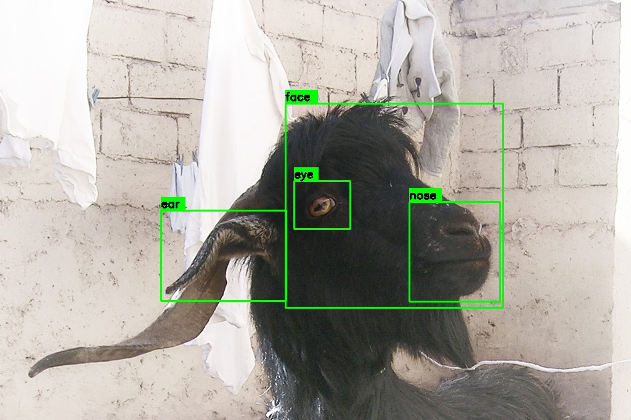
Data Overview
Each image includes YOLO annotations in normalized format (class, x_c, y_c, w, h):
Class 0 — Face
Class 1 — Eye
Class 2 — Nose / Muzzle
Class 3 — Ear
These labels provide a structured representation of goat facial anatomy and are essential for accurate alignment and cropping during the recognition stage.
CSE 803 - 2025

Slide 10
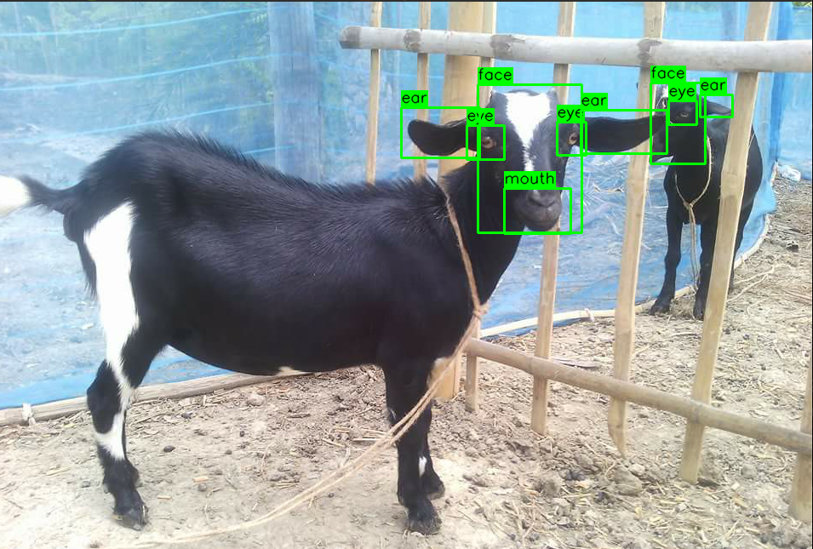
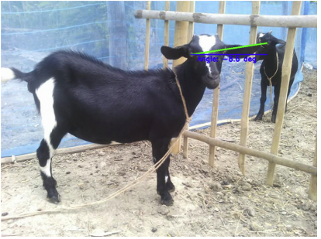
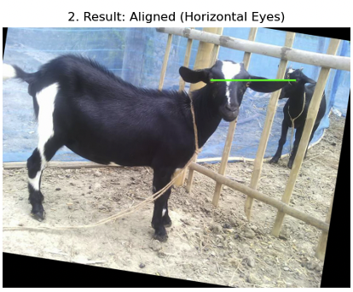
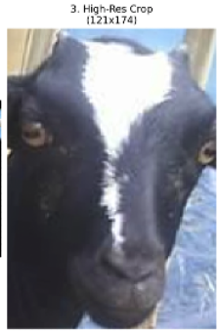
Data Processing – Face Extraction and Alignment
CSE 803 - 2025

Slide 11
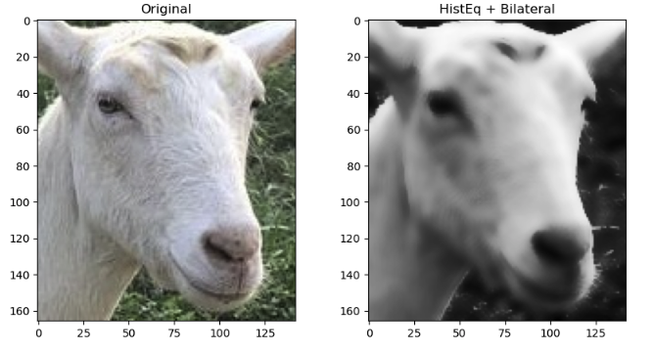
Data Processing – Face Extraction and Alignment
Noise Reduction Using Histogram Equalization and Bilateral Filter
CSE 803 - 2025

Slide 12
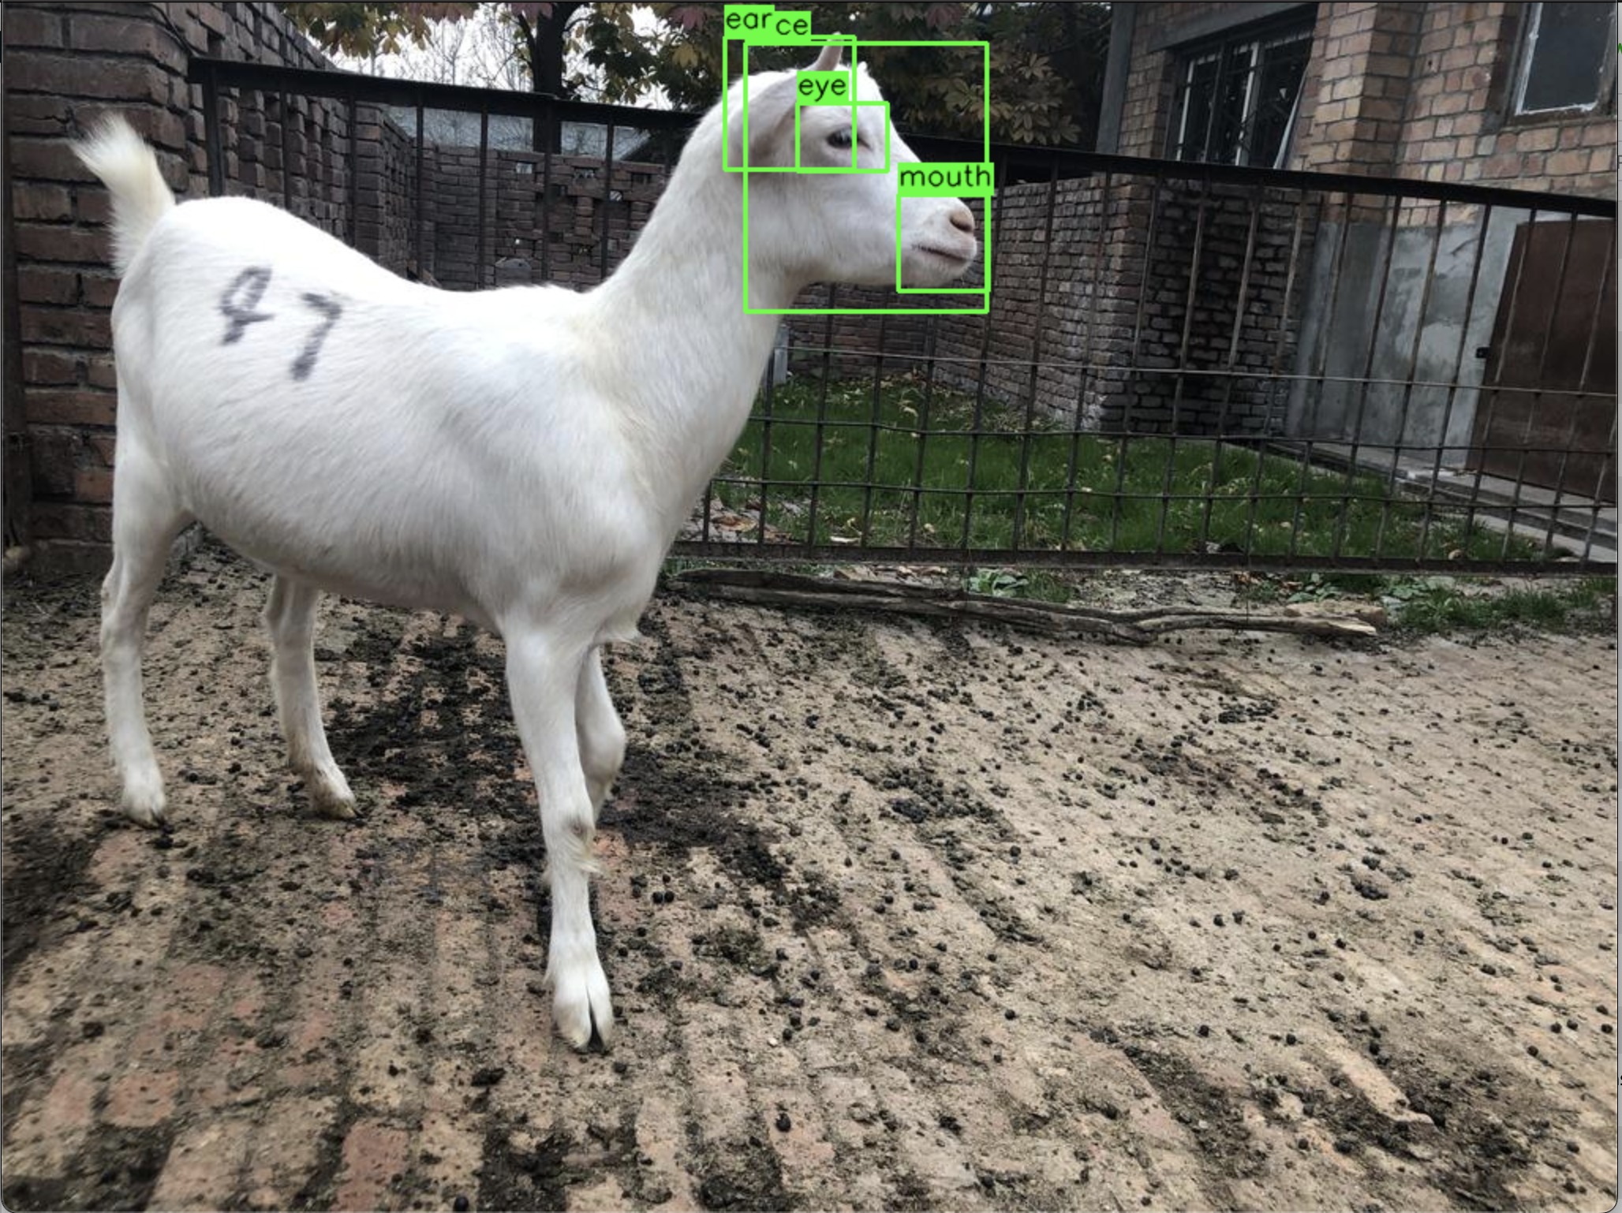
Data Processing – Selection Criteria
Condition for image alignment:
Two eyes most be visible; only then can the centroid and the angle of alignment be calculated
CSE 803 - 2025

Slide 13
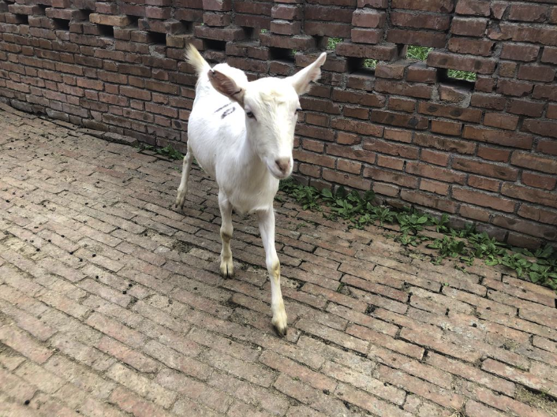
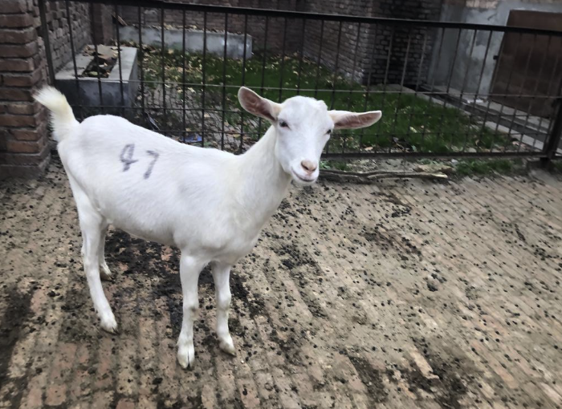
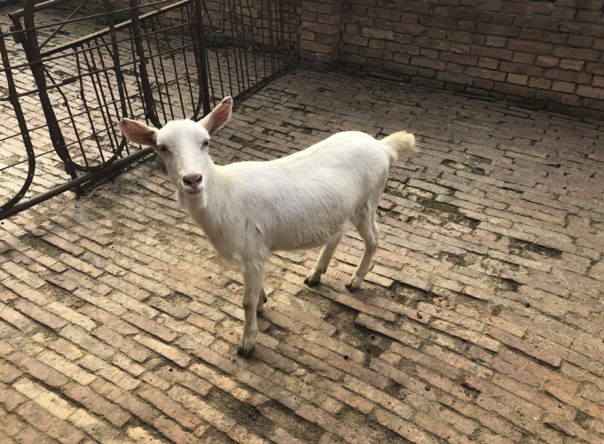
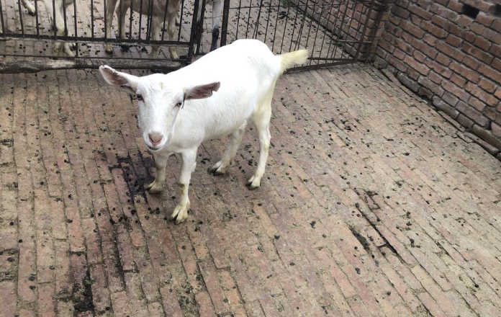
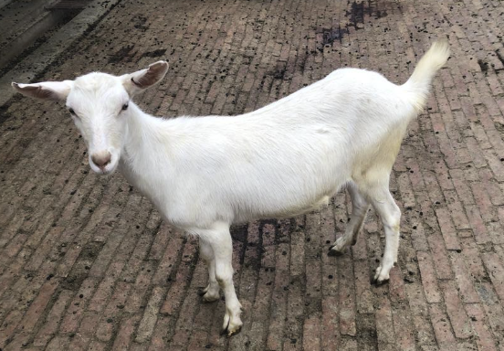
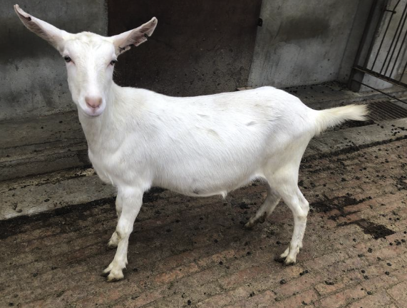
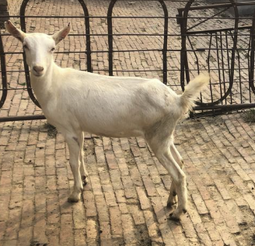
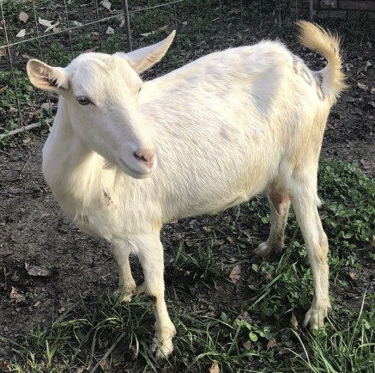
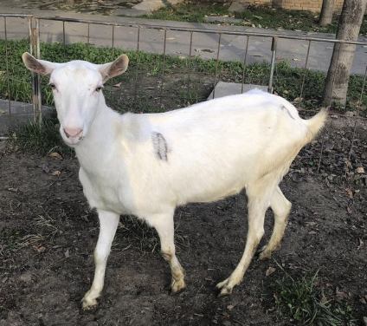
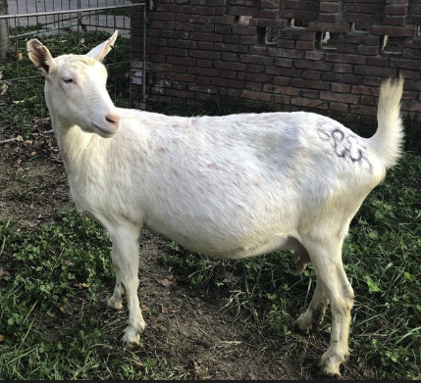
Data Processing – Sample 10 classes
CSE 803 - 2025

Slide 14
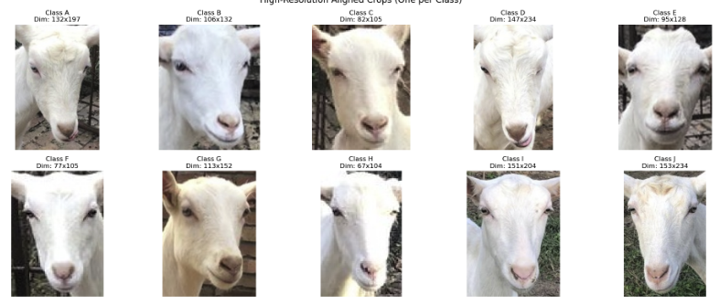
Data Processing – Extracted and Aligned Faces
CSE 803 - 2025

Slide 15
Landmark Detection
CSE 803 - 2025

Slide 16
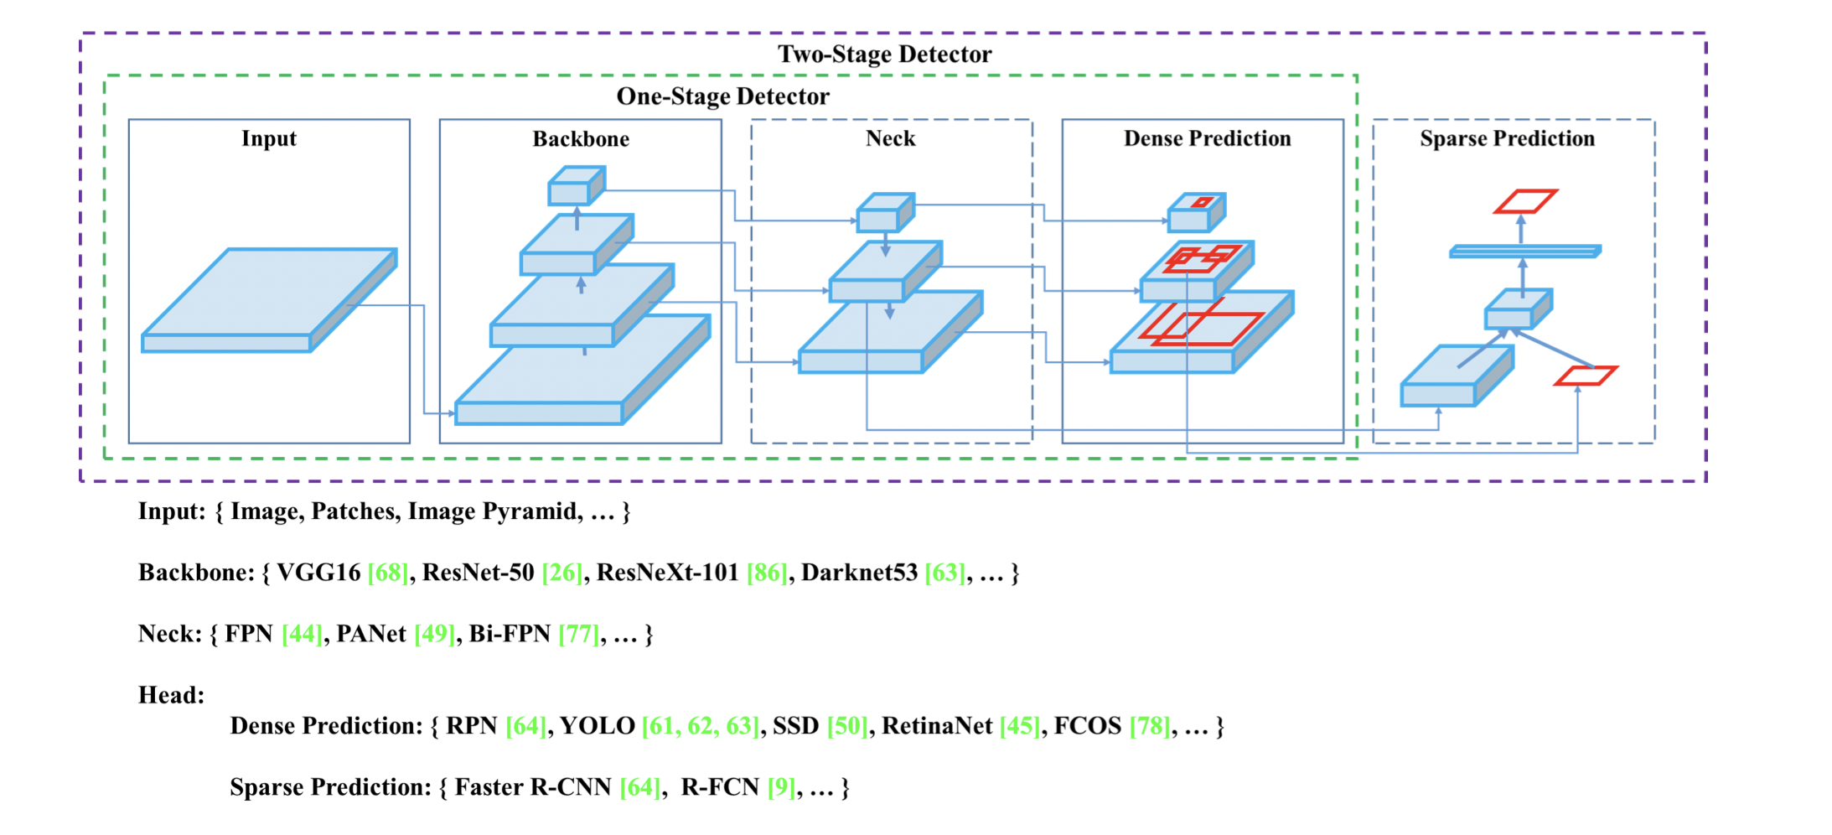
YOLOv4
We use this multistage detection pipeline
Initialize with pretrained YOLOv4 backbone and neck
Modify head for 4 classes
CSE 803 - 2025

Slide 17
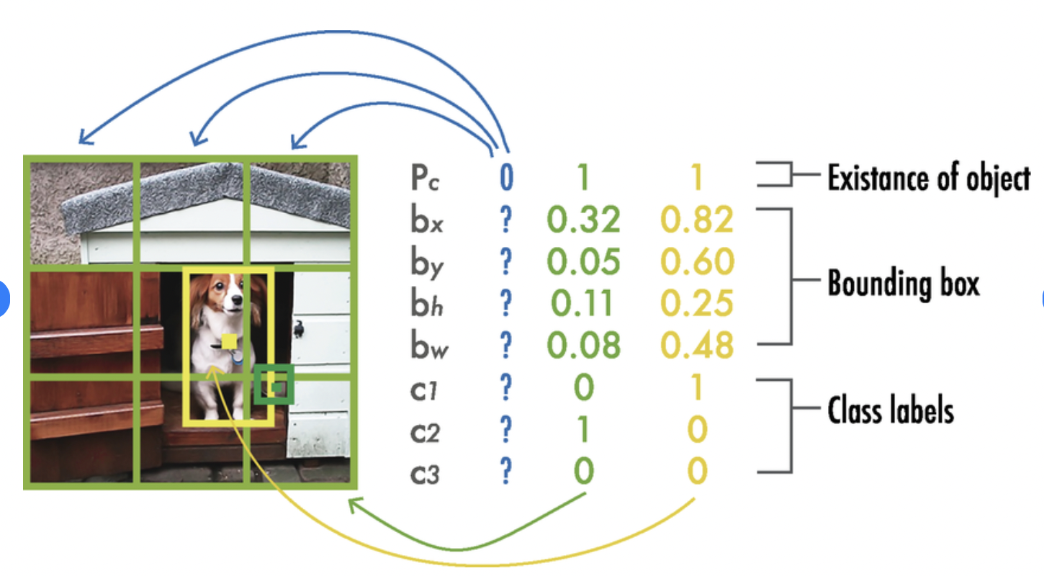
YOLOv4 Output
Losses are based on these outputs :
Localization loss
Objectness loss
Classification loss
CSE 803 - 2025

Slide 18
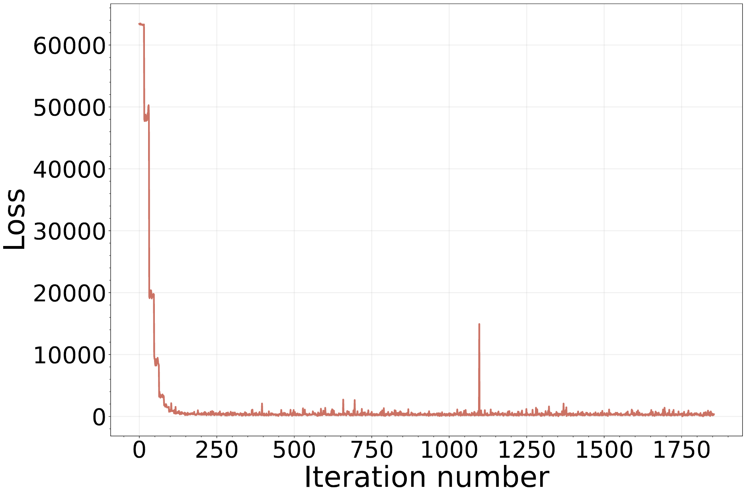
Detection training results
Loss decreases quite well
Unfortunately, the test results do not work
mean Average Precision = 5.9 %
CSE 803 - 2025

Slide 19
Face Recognition
CSE 803 - 2025

Slide 20
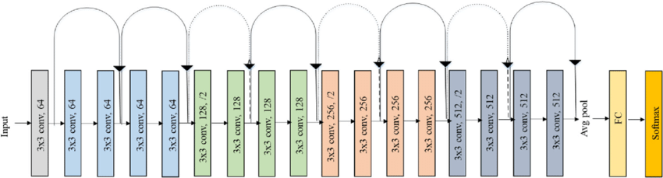
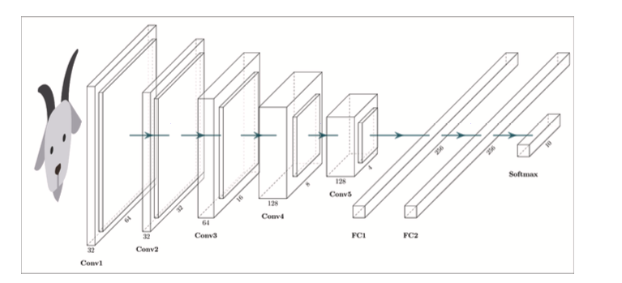
Method- Model Architecture
Architecture from paper
ResNet18
The model was trained using the PyTorch framework with MPS acceleration for 200 epochs, utilizing a Stochastic Gradient Descent (SGD) optimizer (momentum=0.9, decay=1e-4). The training protocol incorporated a regularization strategy featuring 50% Dropout in the classification layers, alongside geometric data augmentation techniques such as random horizontal flips and rotations.
Photo credit – https://www.sciencedirect.com/science/article/abs/pii/S0168169922000473
https://www.researchgate.net/figure/Original-ResNet-18-Architecture_fig1_336642248
CSE 803 - 2025

Slide 21
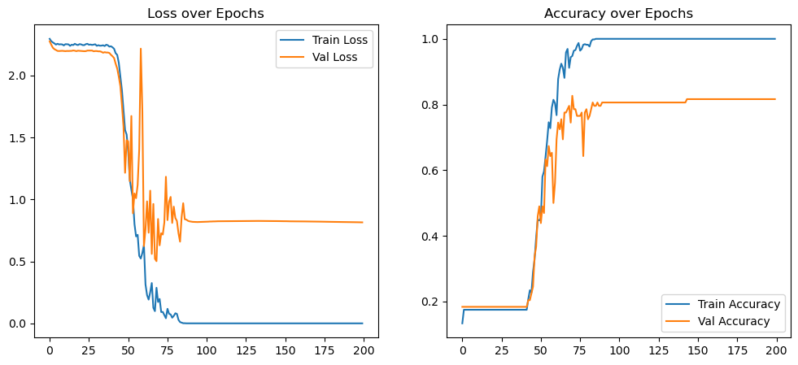
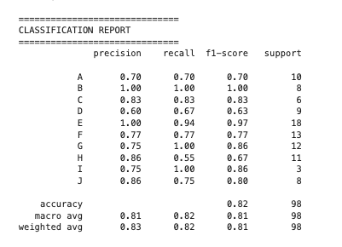
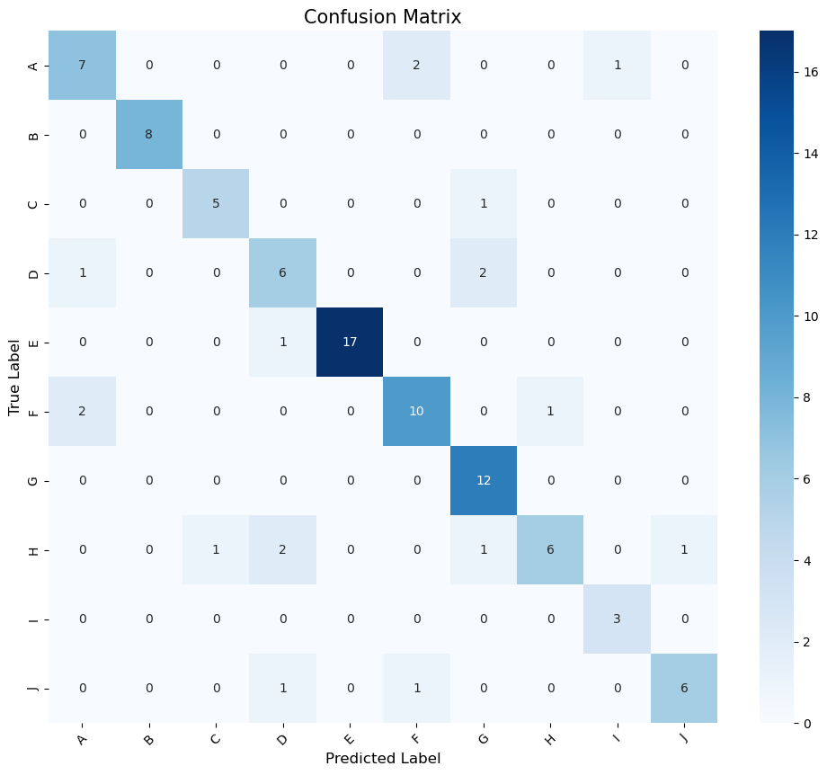
Results Obtained
CSE 803 - 2025

Slide 22
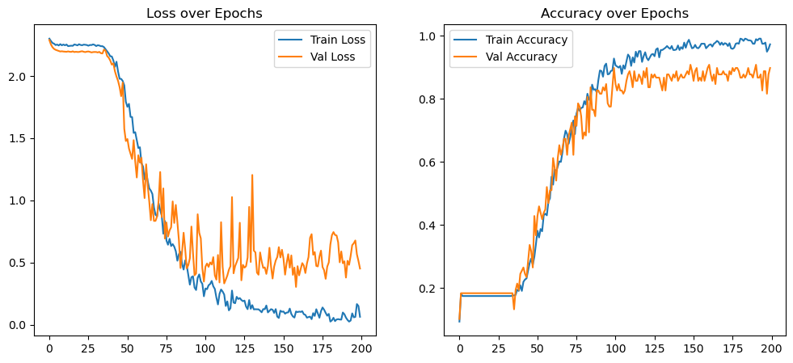
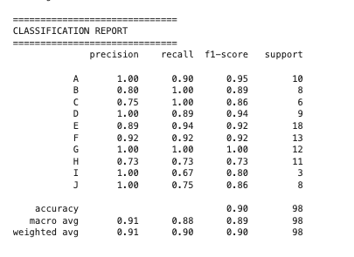
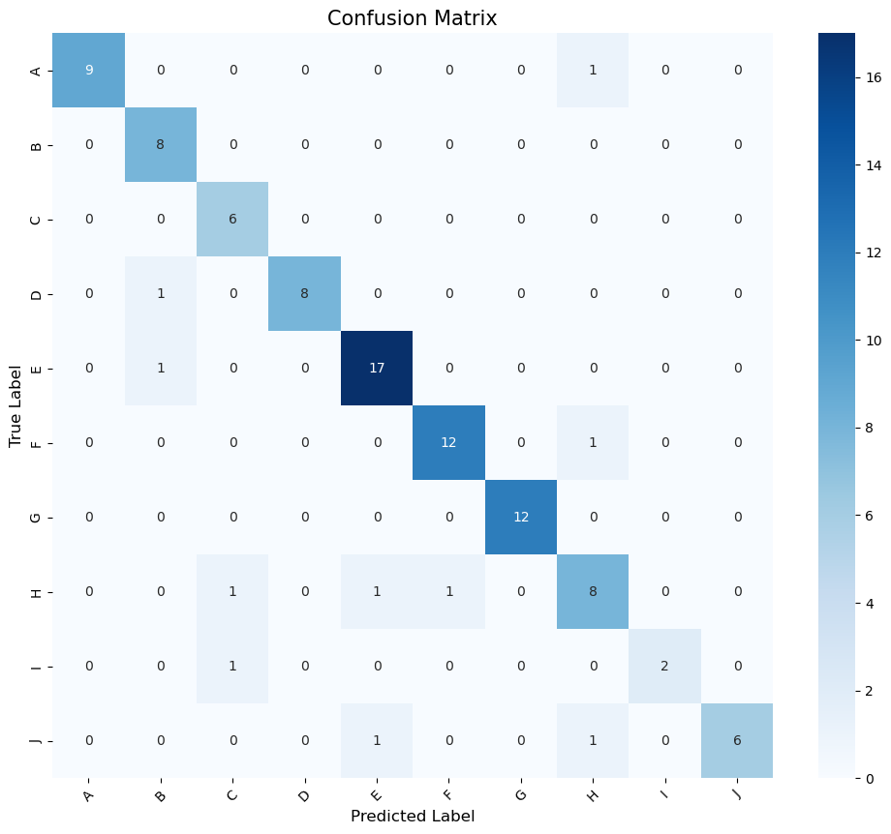
Results – Adding Regularization and Augmentation
CSE 803 - 2025

Slide 23
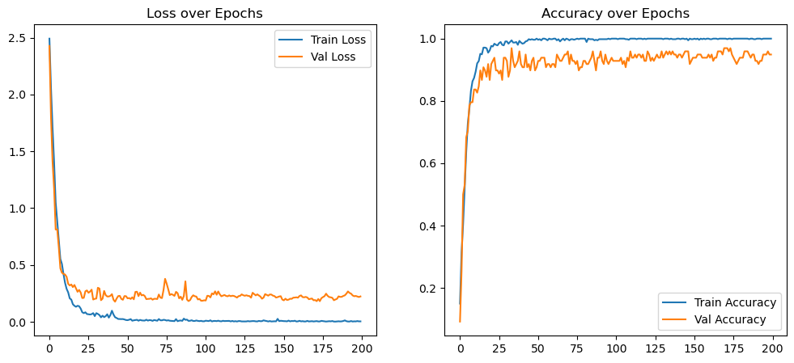
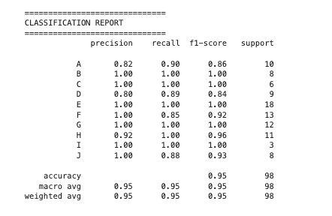
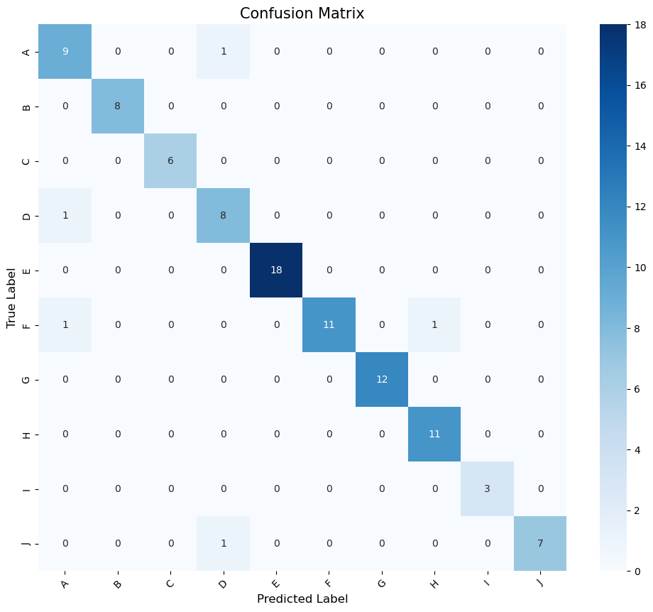
Results – Using Pretrained Network(Resnet18)
CSE 803 - 2025

Slide 24
Comparison Table
Experiment | Dataset Size | Architecture & Method | Accuracy | Key Observations
Authors' Results | 1,500 (Selected from 4,129 raw) | Custom CNN (5-Block) + HistEq & Bilateral Filter | 96.4% | The baseline benchmark. Achieved high accuracy using a specific preprocessing pipeline and a larger dataset.
Analysis 1 (Initial) | ~650 (Total) | Custom CNN (Basic) No Augmentation, Adam Opt. | 81% | Severe Overfitting. The model memorized the small training set (100% train acc) but failed to generalize to the test set (stuck at ~72%).
Analysis 2 (Improved) | ~650 (Total) | Custom CNN (Reg) + Augmentation + Dropout + HistEq/Bilateral | 87% | Successful Regularization. Bridged the overfitting gap. 91% is highly competitive 56% less data than the authors.
Analysis 3 | ~650 (Total) | ResNet18 (Pretrained) + HistEq & Bilateral Filter | 95% | Best Performance. Achieved near-parity with the authors' result (96.4%) despite the small dataset, proving the power of Transfer Learning.
CSE 803 - 2025

Slide 25
Summary and Conclusion
CSE 803 - 2025

Slide 26
Summary
In this project, we replicated the works of Billah et al​ for facial detection and recognition of 10 Saanen goats
Achievement
Successful Implementation of the end-to-end image processing pipeline
Partial Implementation of the detection stack
Full implementation of the facial recognition architecture
Comparable Implementation of a Pretained model for improved performance
Constraint
Although the authors claimed to have used a 1500 dataset for recognition, after implementing their recommended preprocessing workflow, the dataset was reduced to 650
CSE 803 - 2025

Slide 27
Conclusion
Computer vision presents a robust, non-invasive method for achieving precision in livestock farming. In this study, we successfully implemented a CNN framework to identify 10 goats of similar breeds, reaching a peak accuracy of 95% by leveraging Transfer Learning (ResNet18) and a specialized preprocessing pipeline. Our results demonstrate that rigorous data standardization can effectively offset the limitations of small datasets (650 images). This system holds significant potential for real-world applications, including individual health monitoring, precise feed tailoring, and data-driven management. Future work will focus on validating the latency and robustness of this pipeline for real-time deployment in active farm environments.
CSE 803 - 2025

Slide 28
Lesson Learned
This project allowed us to implement a complete pipeline for a time computer vision task, learning how the stack connects.
Generally, as students, we learned that successful Deep Learning implementation relies less on stacking complex layers and more on rigorous data standardization, domain-specific preprocessing, and choosing the right optimization strategy for the available data.
CSE 803 - 2025

Slide 29
Reference
Mahadi Hasan Billah, Mohammad Rashedul Hoque, Ahmed Safa, Rajib Chakraborty, A A Mamun Khan, and Mohammad Shah Alam. Automatic goat face and landmarks detection and identity recognition using deep convolutional neural networks. Computers and Electronics in Agriculture, 194: 106761, 2022. 1, 3
lexey Bochkovskiy, Chien-Yao Wang, and Hong-Yuan MarkLiao. Yolov4: Optimal speed and accuracy of object detection.arXiv preprint arXiv:2004.10934, 2020. 2
CSE 803 - 2025

Slide 30
Thank you!
Q\A
CSE 803 - 2025

